Slide 1
ASSESSEMENT
28-03-25
Presented by S.Vinish

Slide 2
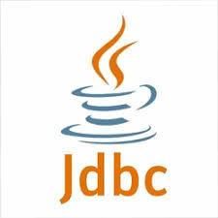
What is JDBC?
JDBC stands for Java Database Connectivity.
It’s API in Java that allows Java applications to connect to and interact with a wide variety of databases.
Key Features: Platform-independent, works with any database that has a JDBC driver (e.g., MySQL, Oracle, PostgreSQL).

Slide 3
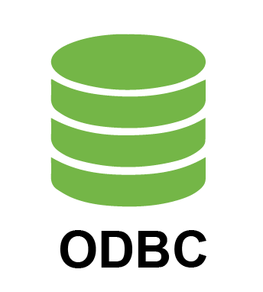
What is ODBC?
ODBC stands for Open Database Connectivity.
It’s a standard API developed by Microsoft for accessing database management systems (DBMS).
Key Features: Provides a uniform way to connect to databases, regardless of the DBMS (e.g., SQL Server, Oracle, Access).

Slide 4
Differences b/w JDBC & ODBC?
Feature | JDBC | ODBC
API Type | Java-based | Language-independent
Platform | Works with Java applications | Works with multiple platforms (C, C++, Python, etc.)
Usage in SAP | SAP NetWeaver Java, SAP PI/PO | SAP Data Services, SAP BW, Legacy integrations

Slide 5
Purpose in SAP
JDBC & ODBC are primarily used for database communication.
JDBC is specific to Java applications, while ODBC provides a broader platform-independent solution.
Both help SAP integrate with non-SAP databases for reporting, ETL (Extract, Transform, Load), and data migration.

Slide 6
Github & it’s purpose in SAP

Slide 7
What is GitHub?
GitHub is a version control and collaboration platform.
It is essential for modern developers.
It provides cloud-based repository hosting.
Over 100 million developers use GitHub worldwide.

Slide 8
GitHub in the SAP Ecosystem
GitHub is transforming SAP development. It enables version control for ABAP code. It drives collaboration on SAPUI5 projects. It supports Infrastructure as Code for SAP deployments.
ABAP Code Management
SAPUI5 Projects
Versioning custom ABAP developments.
Building modern user interfaces.
Open-Source SAP Projects
Contributing to community projects.

Slide 9
Purpose in SAP
Collaboration – Teams can work together on SAP developments.
Version Control – Tracks changes in SAP code efficiently.
Automation – CI/CD workflows help automate deployments in SAP environments.
Security & Backup – Ensures safe code storage and rollback if needed.

Slide 10
Where is GitHub Used in SAP?
SAP Development & DevOps
GitHub is used to manage ABAP, Java, JavaScript, and Python code for SAP applications.
CI/CD Pipelines
GitHub integrates with SAP Cloud Transport Management System (cTMS) and Jenkins for automated deployment.
SAP ABAP Git Integration
abapGit allows version control of ABAP code in SAP systems using GitHub.
Integration with SAP Business Technology Platform (BTP)
GitHub is used to store and manage SAP CAP and RAP projects.
SAP Data & AI Projects
Used for version control in SAP HANA ML, Python-based AI, and data science models.

Slide 11
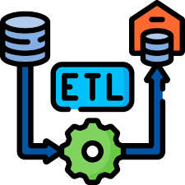



What is ETL?
Extract
Transform
Load
Reading data from various source systems such as SAP, databases, and files.
Cleaning, converting, and transforming data to meet target system requirements.
Writing the transformed data into the target system, like a data warehouse.
ETL, which stands for Extract, Transform, Load, is a critical data integration process. It's designed to load data into a data warehouse or another target system, ensuring the data is clean, consistent, and ready for analysis. It’s used in almost every industry.

Slide 12
Where is ETL Used in SAP?
📌 SAP BW / SAP BW on HANA 📌 SAP S/4HANA Migrations
📌 Data Lake / Big Data Integration 📌 Real-Time Data Replication
📌 SAP Analytics Cloud (SAC)
For data warehousing and reporting.
Extracts data from legacy systems, transforms it, and loads it into S/4HANA.
Moves SAP data into AWS, Azure, or Google Big-Query.
SAP SLT replicates data into SAP HANA for real-time analytics.
Uses ETL to fetch data for dashboards & analytics.

Slide 13




ETL Tools
SAP Data Services (BODS)
ETL & data integration tool used for data migration & data warehousing.
SAP BW (Business Warehouse)
Uses Process Chains & Data-Sources for ETL processing.
SAP HANA Smart Data Integration (SDI)
Real-time ETL for SAP HANA.
Open-Source Options
Such as Apache Kafka and Apache Spark offer flexible, community-driven solutions, providing cost-effective alternatives for specific ETL needs.

Slide 14
Thank You

